Slide 1
A Modern Approach to Predicting CO2 emissions in Canadian ICE (Internal Combustible Engines)
DATA 621: Fall 2020
Group 3
Zach Alexander, Sam Bellows, Donny Lofland, Joshua Registe, Neil Shah, Aaron Zalki

Slide 2
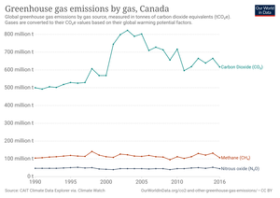
Introduction & Motivation
Climate Change is a top priority in 2019
Economic damage projected 1.5-25% GDP through end of century
Supported by majority of Canadians
Canada dichotomous energy/climate change
10% GDP still fossil fuel related
Major exports are oil, gasoline and cars

Slide 3
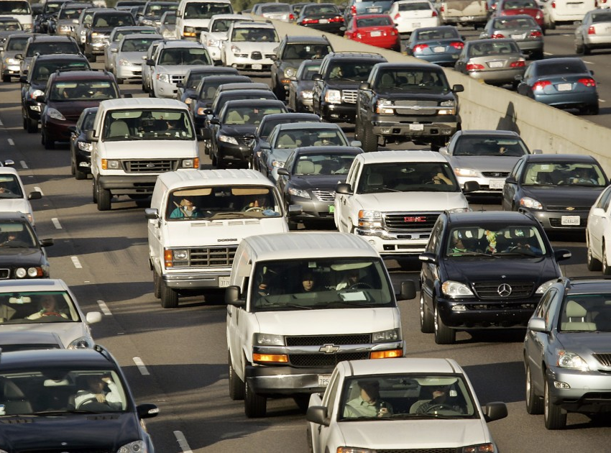
Introduction & Motivation
In 2019 Policy makers adopt Low Carbon Fuel Standard (LCFS) for Canada
Modeled after California
Reduce CO2 emissions in vehicles by fuel source
How can one quantify and predict CO2 emissions in a diverse automotive fleet such as Canada?

Slide 4
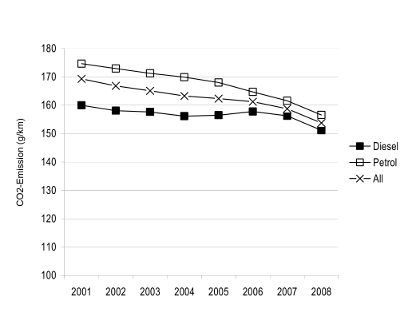
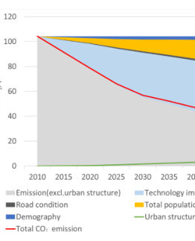
Literature Review
Previous research focused on different representations of vehicle carbon emissions
Theoretical Physical model of vehicle with rolling resistance, friction and other parameters (Fontaras & Panagiota, 2011)
Linear model with factors such as mass, car type, engine or fuel (G. Mellios, 2011)
Aggregate systems of traffic (multiple cars) as a stream (Kevin R. Gurney, 2012)
Traffic dynamics involving changing population (Kii, 2020)

Slide 5
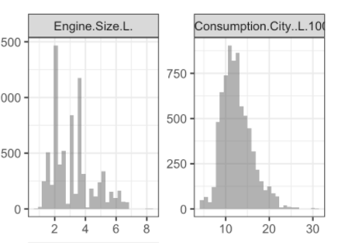
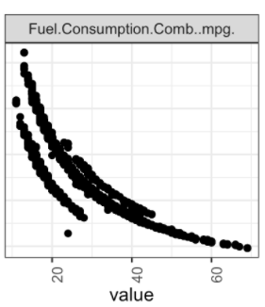
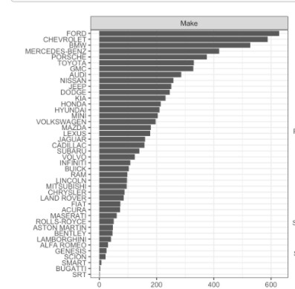
Exploratory Data Analysis
Generated distribution on categorical and numerical features
Engine Size [Displacement]
Fuel Economy
Make of Vehicle
Class of Vehicle [SUV, Compact Mid-Size, etc]
Type of Transmission
Number of Cylinders

Slide 6
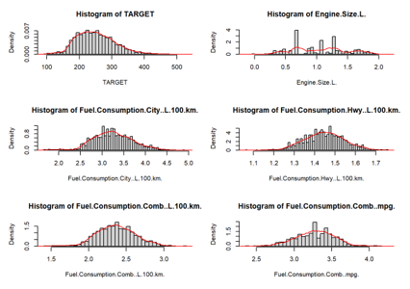
Data Preparation
Transformed numeric features to ensure near-normal distributions. Utilized the boxcox transformation to ensure constant variability in the features as well. Transformed features include:
TARGET (emissions)
Engine Size
Fuel Consumption by type of road

Slide 7

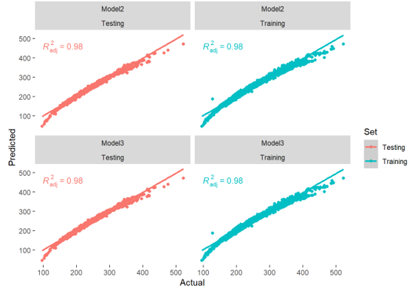
Model Results
Model 1 included only the engine size and fuel consumption features.
Model 2 included all features.
Model 3 included only statistically significant features from Model 2.
We believe that Model 3 is the best model as it shows very high correlation between features and targets, while also reducing the complexity of model 2 by removing unnecessary features.

Slide 8
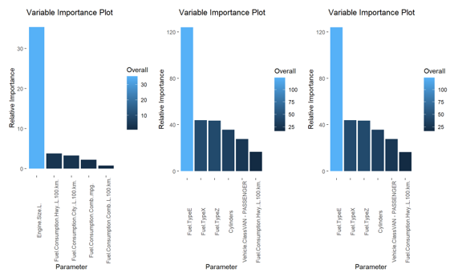
Feature Importances
The 3 models share many features they think are important.
Clearly, the most important features for predicting emissions are fuel type, engine size, and fuel consumption.
According to our model coefficients, using ethanol or natural gas instead of gasoline greatly reduces emissions.
Smaller engine size tends to reduce emissions as well.

Slide 9
References
Full GitHub Repo: https://github.com/djlofland/DS621_F2020_Group3/tree/master/Final%20Project
(2019). Clean Fuel Standard. Environmental Change of Canada . Retrieved from https://www.canada.ca/content/dam/eccc/documents/pdf/climate-change/pricing-pollution/Clean-fuel-standard-proposed-regulatory-approach.pdf
Fontaras, G., & Panagiota, D. (2011). The evolution of European passenger car characteristics 2000–2010 and its effects on real-world CO 2 emissions and CO 2 reduction policy . Energy Policy.
G. Mellios, S. H. (2011). Parameterisation of fuel consumption and CO 2. JRC Scientific and Technical Reports.
Government du Canada . (n.d.). Retrieved from Energy and the economy: https://www.nrcan.gc.ca/science-data/data-analysis/energy-data-analysis/energy-facts/energy-and-economy/20062
Hope, C., & Alberth, S. (2008). The Cost of Climate Change: What We’ll Pay if Global Warming. NRDC.
J.A. Paravantis *, D. G. (2006). Trends in energy consumption and carbon dioxide emissions. Technology in Forecasting and Societal Change.
Kevin R. Gurney, I. R. (2012). Quantification of Fossil Fuel CO 2 Emissions on the Building/Street. Environmental Science and Technology.
Kii, M. (2020). Reductions in CO 2 Emissions from Passenger Cars in Japan under Population and Technology. Sustainability .
Molico, M. (2019, November 19). Researching the Economic Impacts of Climate Change. Retrieved from Bank of Canada : https://www.bankofcanada.ca/2019/11/researching-economic-impacts-climate-change/
Nadia, P. (2020, Feb 20). Climate Change Rises as a Public Priority. But It’s More Partisan Than Ever. Retrieved from New York Times: https://www.nytimes.com/interactive/2020/02/20/climate/climate-change-polls.html
Shah, M. (2019, October 9). Climate change emerges as one of the top ballot-box issues among voters. Retrieved from https://globalnews.ca/news/6006868/climate-change-federal-election-issue-poll/
Tabuci, H. (2018, April 2). New York Times. Retrieved from Calling Car Pollution Standards ‘Too High,’ E.P.A. Sets Up Fight With California: https://www.nytimes.com/2018/04/02/climate/trump-auto-emissions-rules.html
Toshiko, N. (2003). Energy Modeling on Cleaner Vehicles in Japan. Journal of Cleaner Productio

